Slide 1
Решетникова Елена Леонидовна учитель английского языка
Манюшкина Инна Михайловна учитель иностранных языков
Муниципальное бюджетное общеобразовательное учреждение средняя общеобразовательная школа №5
ХМАО-ЮГРА, Тюменская область, город Сургут
ИГРОВОЕ МЕРОПРИЯТИЕ ДЛЯ 6-Х КЛАССОВ «DREAM TEAM»
WELCOME
5 августа 2015 г.
Третья летняя Всероссийская конференция 2015 года
"Актуальные проблемы теории и практики образования"

Slide 2
Sport games | 200 | 400 | 600 | 800 | 1000
Weather | 200 | 400 | 600 | 800 | 1000
Animal life | 200 | 400 | 600 | 800 | 1000
Healthy Way of life | 200 | 400 | 600 | 800 | 1000

Slide 3
200
1. 200 points. Name the game played between two teams of eleven players who kick a ball around a field trying to score a goal.

Slide 4
200
Is it cold in summer?

Slide 5
200
1. What animals are found only in Australia?

Slide 6
200
1. What dairy products do you know?

Slide 7
400
People played this game in England as early as
1550.

Slide 8
400
Are there 30 days in November?

Slide 9
400
Why do people hunt Indian tigers?

Slide 10
400
What food is good for people’s health?

Slide 11
600
This game is played by two teams of 6 players each on an ICE Field.

Slide 12
600
What are the names of the winter months in Russia?

Slide 13
600
Where can we find the names of some animals, birds and fish which are disappearing nowadays?

Slide 14
600
What are the things that help us to keep fit?

Slide 15
800
It is a game of two players. Each of them starts
with sixteen different playing pieces to move on a board. The aim is to move your pieces so that your opponent’s king will be taken.

Slide 16
800
How many months are there in the year?

Slide 17
800
What animals were brought to Australia and became wild?

Slide 18
800
Which parts of human body can suffer from television and computer?

Slide 19
1000
This game was first played in England in 1872 and the first championship at Wimbledon was in 1877.

Slide 20
1000
How many seasons are there in Great Britain?

Slide 21
1000
It is green and big. It likes meat. It lives in the river. What animal is it?

Slide 22
1000
What antibiotic was discovered by Alexander
Fleming in 1928?

Slide 23
Ted
It’s high time for to go to bed.
It’s time for to have her dinner.
It’s time for to feed her pussy.
It’s time for to come to you.
It’s time for to tell the truth.
It’s time for to come to the party.
It’s time for to press her dress.
It’s high time for to say goodbye and leave.
It’s high time for to learn about this.
It’s high time for to come to the class.
Tina
Lucy
Sue
Ruth
Marty
Bess
Steve
Chris
us

Slide 24
Скажи в прошедшем времени
I went to school last week.
1. I go to school every day.
2. I see my friend and his mother.
3. We take a beautiful pencil-box.
4. He gives me two exercise-books.
5. Jake gets up at seven o’clock.
6. Children can play hockey very well.
7. I like this toy very well.
8. The weather is fine today.
9. My sister does her homework every evening.
10. They have Maths every day.
I saw my friend and his mother.
We took a beautiful pencil-box.
He gave me two exercise-books.
Jake got up at seven o’clock.
Children could play hockey very well.
I liked this toy very well.
The weather was fine last month.
My sister did her homework yesterday evening.
They had Maths on Monday.

Slide 25
Конкурс капитанов.
Complete the sentences.
I like to eat …
We play … in the forest.
My friend doesn’t like … .
Would you like some … ?
He can’t … .
Do you drink … for breakfast?

Slide 26
Подбери рифму:
letter
Better
Long
Play
Page
Start
Uniform
Go
My
Choose
Mouse
song
say
age
art
form
no
buy
use
house

Slide 27
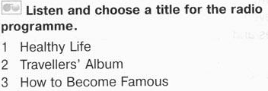
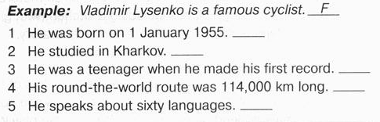

Slide 28
