Slide 1
Войцеховская Светлана Ивановна учитель английского языка
Государственное бюджетное образовательное учреждение школа № 598 г. Санкт-Петербург
КОНСПЕКТ УРОКА ПО АНГЛИЙСКОМУ ЯЗЫКУ В 6 КЛАССЕ
«SPORTSANDGAMES» (ВИДЫСПОРТА)
Третий Всероссийский фестиваль передового педагогического опыта
"Современные методы и приемы обучения"
март - май 2015 года

Slide 3


Slide 4

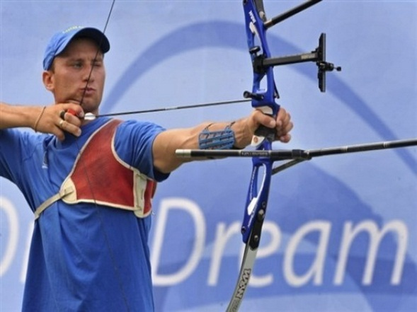
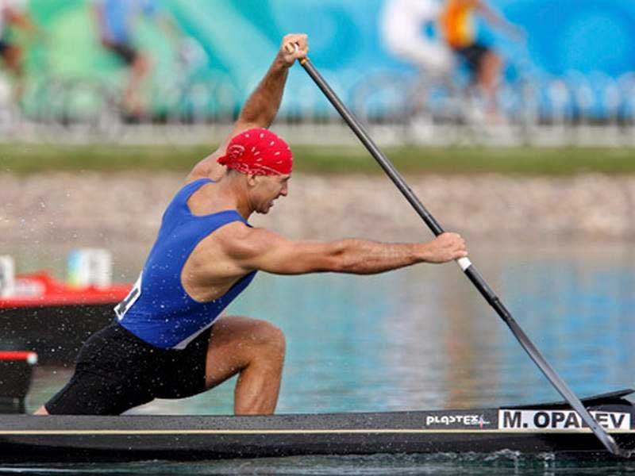
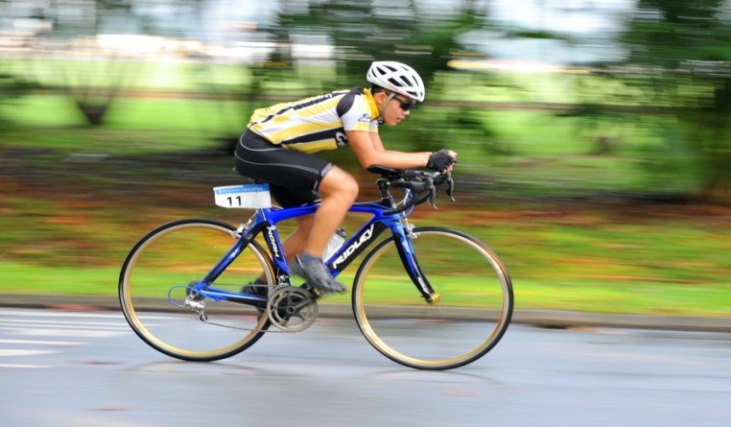
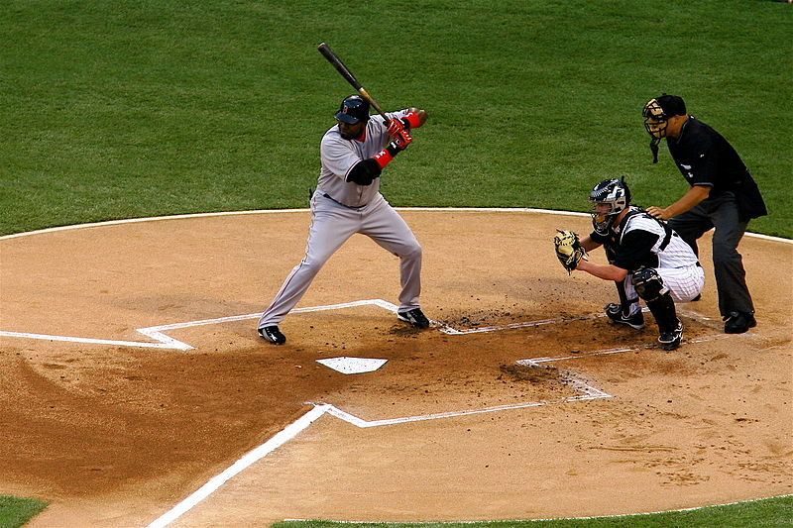
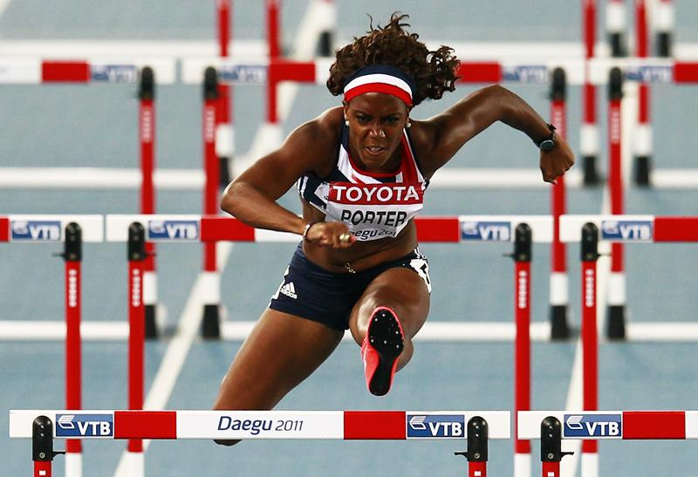
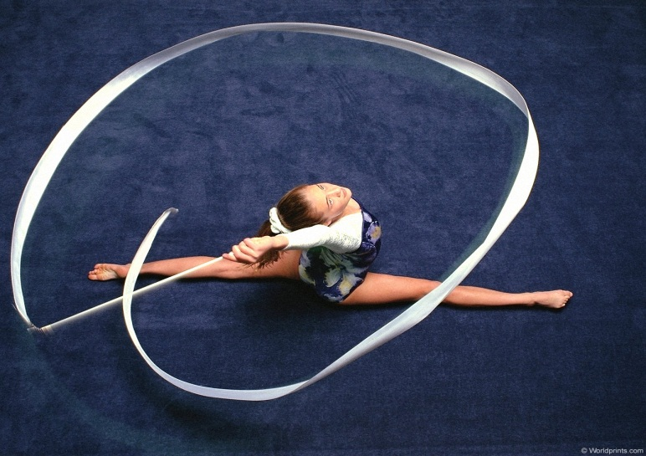
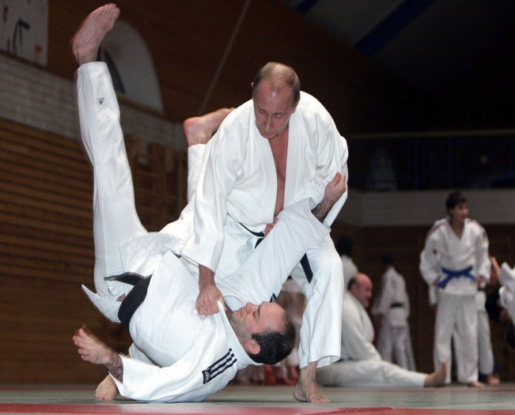

Slide 5

YOU CAN GUESS
The sport of running fast
and jumping high
The sport of using a bow and arrows. Robin Hood was good at it.

Slide 6
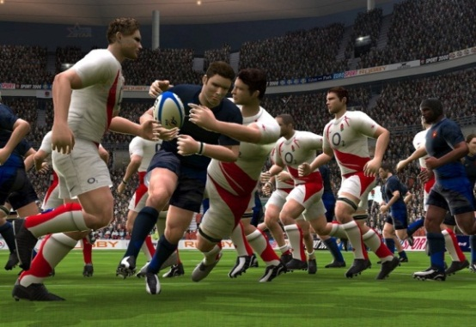


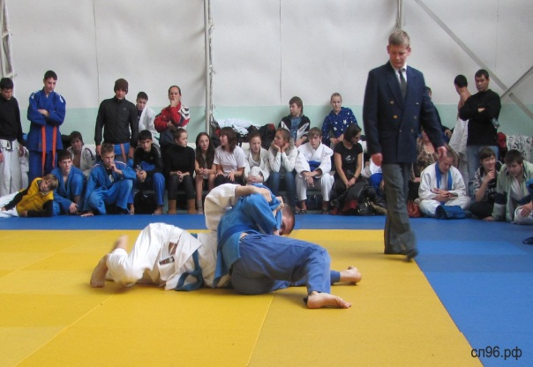
The sport of running with the ball and
trying to get over a line to score
The sport of playing on ice
and hitting a puck with a stick
The sport of moving down
snowy hill wearing a board
The sport of throwing
the opponent to the carpet

Slide 7
YOUR HOME TASK
1st TASK: WB ex.1, 2 p.76
CHOOSE 2nd TASK :
Word puzzle. Make as many sports as possible with the letters of BASKETBALL
2. Write 5 similar questions of your own as in Quiz YOU CAN GUESS

