Slide 1
Разработка урока английского языка в 8 классе (в рамках регионального компонента)
Лобанова Светлана Геннадьевна
учитель английского языка
Муниципальное бюджетное общеобразовательное учреждение
«Средняя школа №72 с углубленным изучением английского языка»
Кемеровская область, г.Новокузнецк
Вторая Всероссийская научно-методическая конференция, 10 ноября 2014 - 10 февраля 2015
"Педагогическая технология и мастерство учителя"

Slide 2
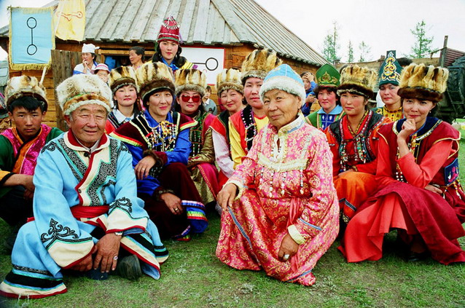
Native people of the Kemerovo region: customs, traditions, way of life

Slide 3
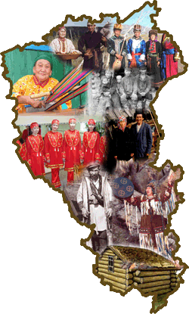
Our people
On the territory of the Kemerovo region live more than 100 nations, nationalities, ethnic groups. The most numerous national groups are Russians, Tatars, Ukrainians, German people, Chuvashes.
But our native people are Shors and Teleuts.

Slide 4
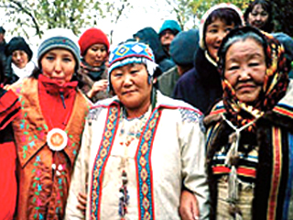
Some facts from the history
Shors
Those were forest settled tribes. The chief of a family was a prince.
In the past Shors’ religion were shamanism and animism.
They had no writing.
Each tribe had the hunting grounds and arable lands.
Settled Shors were engaged in ore smelting, blacksmithing, making primitive hand-made articles for hunting and agriculture.
On the lands cleared away from the wood Shors grew wheat, hemp, barley. They were also engaged in collecting nuts, berries, Peony roots, etc.
Find out the meaning of the underlined
words and phrases in a dictionary

Slide 5
Some facts from the history
Teleuts
Came from the tribes and accepted a settled way of life.
Their main occupations were collecting (berries, roots, nuts, eggs of wild birds), hunting (for food and animals skin to make clothes and shoes) and fishing.
Teleuts had no writing.
Their religion was shamanism.
In the 17 century Teleuts established
the military-political union with Russians
about non-aggression and trade relations.
Find out the meaning of the underlined
words and phrases in a dictionary

Slide 6
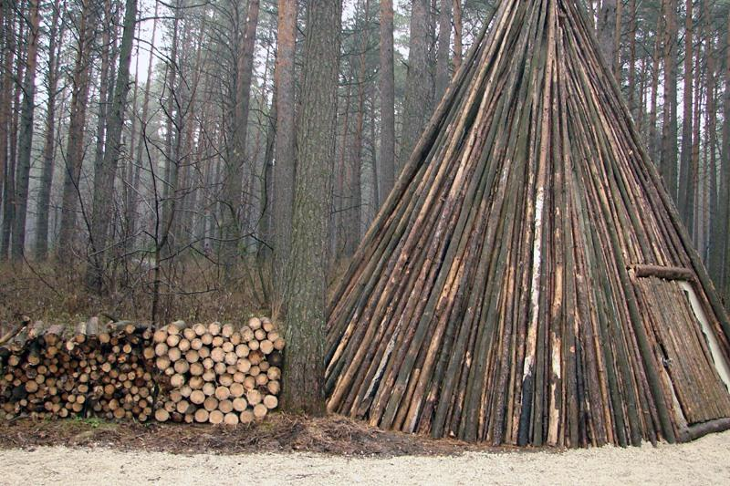
Dwelling of Shors
Small settlements of Shors — uluses - in the North and in the south were often moved to a new place on the occasion of change of an arable land, death any of relatives, etc. Consisted of several cone-shaped houses (yurtas) made of trees’ trunks.
Poor people lived in semi-dugout constantly, warming them with birch bark and the earth.
Find out the meaning of the underlined
words and phrases in a dictionary

Slide 7
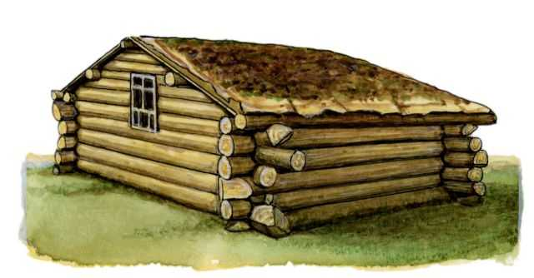
Dwelling of Shors
In the XIX century the Shors had log huts of the Russian type.
Modern Shors live in the peasant’s houses, hunting dwellings. Yurtas are used as summer kitchens.
Find out the meaning of the underlined
words and phrases in a dictionary

Slide 8
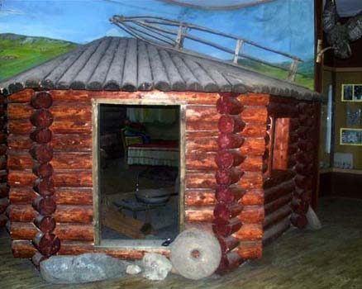
Dwelling of Teleuts
Characteristic types of the dwelling at this time were conic constructions from poles and bark, a rectangular semi-dugout with a flat roof. Walls were laid with turf. There was a furnace to the right of the entrance focused to the east.
By the beginning of the
XX century four - or five-wall
log huts were very popular
among Teleut people.
They also built barns,
shelters for cattle and hen
houses.
Find out the meaning of the underlined
words and phrases in a dictionary

Slide 9
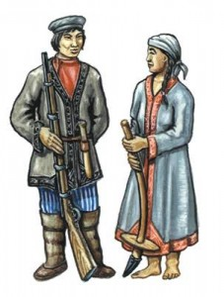
Traditional clothes of Shors
The men and women clothing consisted of a shirt, trousers and a dressing gown with an embroidery. In winter they also put on some warm dressing gowns made of sheepskin fur that were tied round by a belt.
Shors’ footwear were made of leather.
Women carried scarfs, men — caps made of fabric, skin or birch barks. The top of their caps could have embroidery. The winter headdresses were made of fur.
Find out the meaning of the underlined
words and phrases in a dictionary

Slide 10
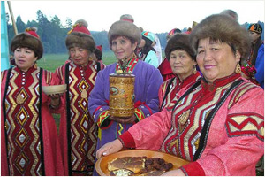
Traditional clothes of Teleuts
Women's shoes and boots are made of a sheepskin or skin, with high tops and with an embroidery wool or silk on lifting.
The Teleuts’ headdresses are conic caps made of velvet have a beaver or a sable fur fringe and a brush on the top.
Jewelry –earrings, rings, rings, bracelets, brooches are made of copper and silver.
Find out the meaning of the underlined
words and phrases in a dictionary

Slide 11
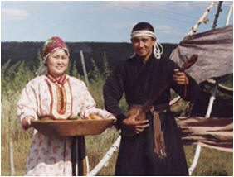
Folklore of Shors and Teleuts
Shors’ and Teleuts’ folklore is rich developed: fairy tales, stories and legends, songs, sayings, proverbs and riddles.
One of the brightest genres of folklore is the heroic epos performed by storytellers to the accompaniment of a string instrument made of a willow or a cedar with the resonator from a horse skin.
Historical legends and the songs reflect events of times of Teleut jungar wars and a hunting way of life.
The ritual folklore includes the poems connected with a family and household ceremonies, a funeral crying. Song dance tunes are accompanied by the Russian balalaika or accordion.
Spring games with songs are also known.
Find out the meaning of the underlined
words and phrases in a dictionary

Slide 12
Compare facts about Shors and Teleuts and fill in the table
 | Common features | Differences
Shors
Teleuts

Slide 13
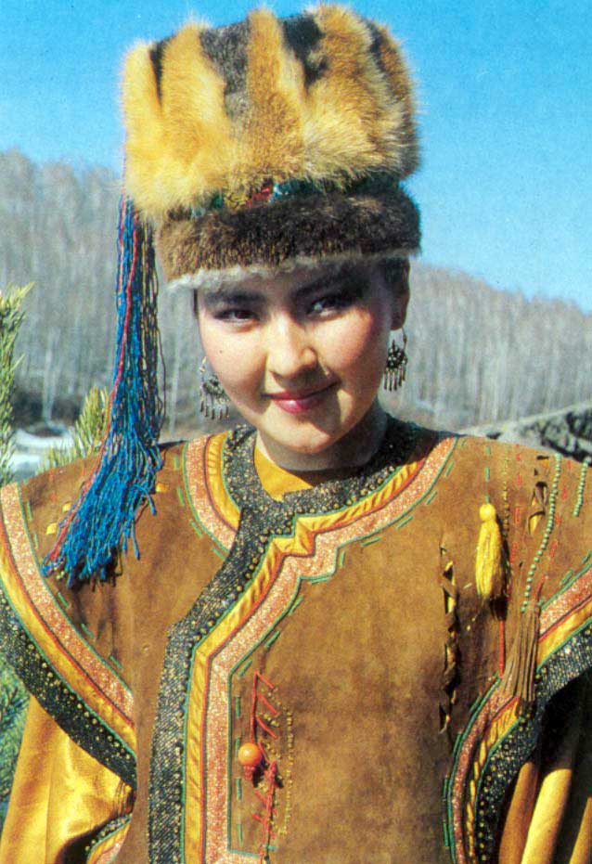
Thanks for
attention!

