Slide 1
Sport in Our Life
(Спорт в нашей жизни)
Теплякова Ольга Сергеевна
учитель английского языка
Муниципальное бюджетное общеобразовательное учреждение
«Новолядинская средняя общеобразовательная школа»
р.п.Новая Ляда Тамбовского района
Тамбовской области
Вторая Всероссийская научно-методическая конференция, 10 ноября 2014 - 10 февраля 2015
"Педагогическая технология и мастерство учителя"

Slide 2
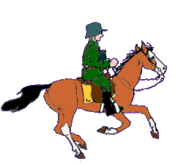
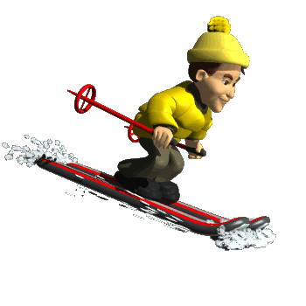

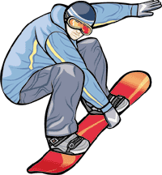

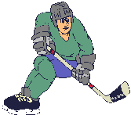
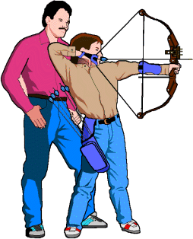

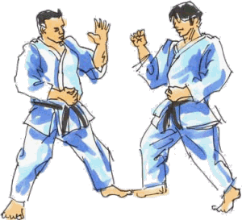

Sport in
our life

Slide 3
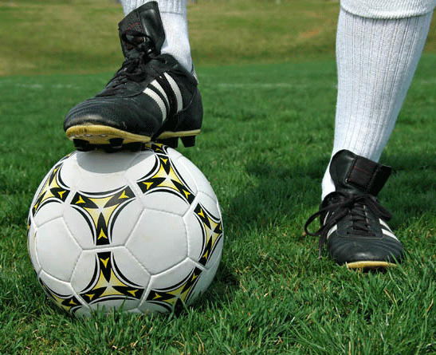
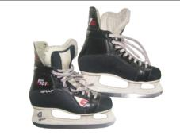
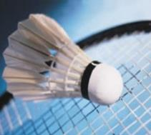

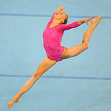
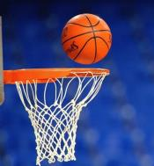
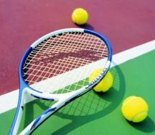
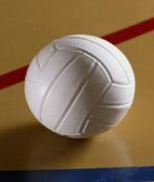
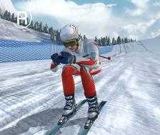
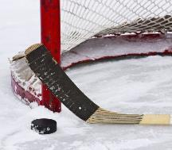
NAME THESE SPORTS
AND GAMES
FOOTBALL
ICE SKATING
BADMINTON
BOXING
GYMNASTICS
BASKETBALL
TENNIS
VOLLEYBALL
SKIING
HOCKEY

Slide 4
Do you like sport?
Do you prefer going in for sports or watching it on TV?
What kinds of sports are popular in Russia?
What national English sports do you know?

Slide 5
Favourite kind of sport in your group
Interview your classmates, complete the table and report the results.
Model: Dima likes football
Ann’s favourite sport is skiing.

Slide 6
Match the words in English and in Russian.
diving | прыжки в воду
wrestling | легкая атлетика
athletics | конный спорт
hiking | велоспорт
cycling | кёрлинг
curling | спорт. борьба
biathlon | горный туризм
archery | парусный спорт
cricket | стрельба из лука
sailing | биатлон
horse racing | крикет

Slide 7
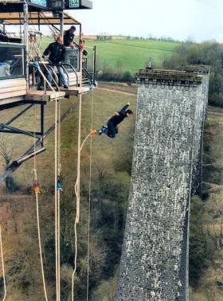
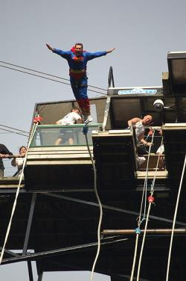
Bungee jumping
Bungee jumping is jumping from a tall structure while connected to a large elastic cord. The tall structure is usually a fixed object, such as a building or bridge.

Slide 8
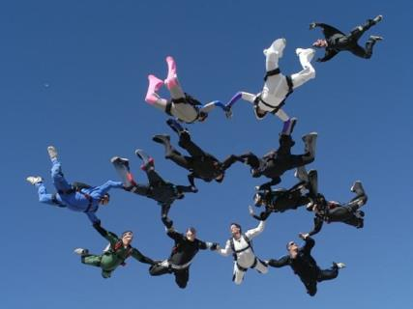

Skydiving
Skydiving, also known as parachuting, is the activity of performing acrobatics during freefall.

Slide 9
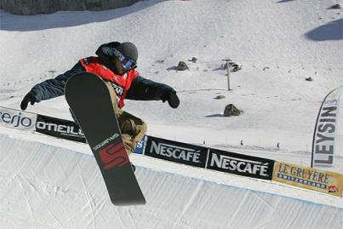
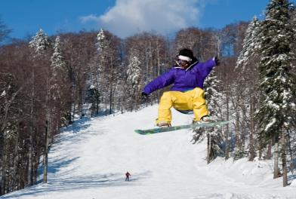
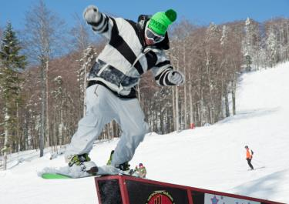

Snowboarding
An activity or sport of standing on a short wide board and
moving very fast down a hill covered with snow

Slide 10
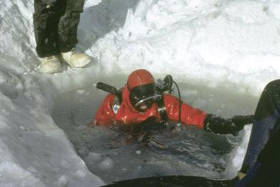
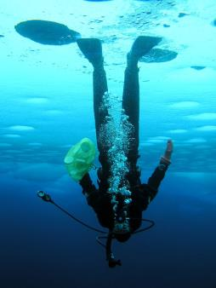
Ice diving
An extreme sport
in which you dive through a hole into a very cold sea that has ice
on the top.

Slide 11
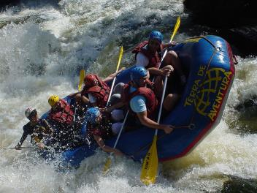
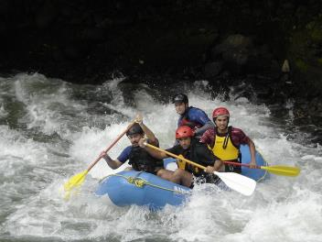
White Water Rafting
A sport or activity
of moving a rubber boat through water and
round rocks in a river
that is flowing very fast

Slide 12
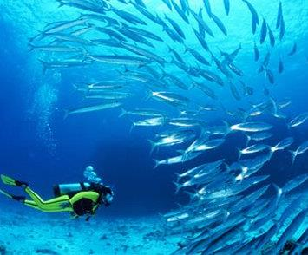


SCUBA-DIVING
A sport or activity
of swimming underwater
with a scuba

Slide 13
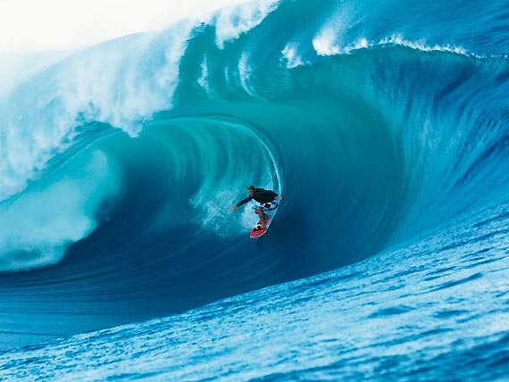
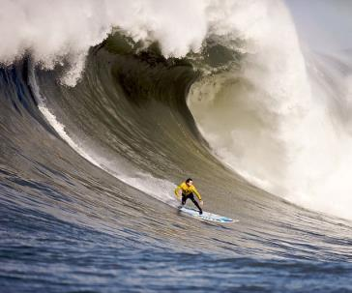
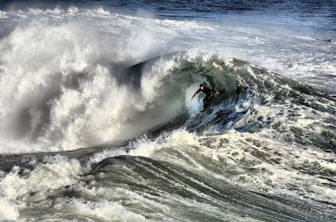
A sport or activity
of standing
on a long flat board
and moving across
waves in the sea
Surfing

Slide 14
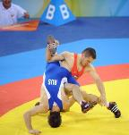

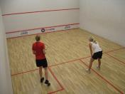
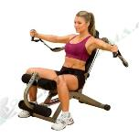
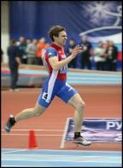
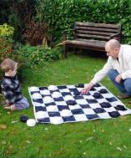
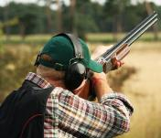
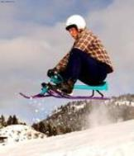
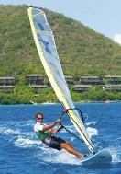
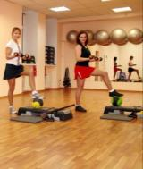
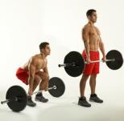
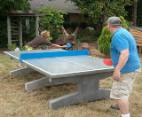
Match the sport and its name
1
9
8
wrestling
ping-pong
fitness training
aerobics
bowling
karate
weight training
athletics
yachting
shooting
windsurfing
tobogganing
squash
2
4
10
3
11
12
13
5
7
6

Slide 15

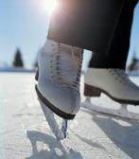
Group these activities into indoor and outdoor sports.
sailing
skating
surfing
baseball
diving
bowling
tennis
handball
horse-racing
wrestling
ice hockey
archery
volleyball
horse-racing
ice hockey
volleyball
diving
volleyball
Indoor
sports
Outdoor
sports
tennis
archery
bowling
sailing
baseball
handball
tennis
wrestling
skating
surfing

Slide 16
What sport we CAN…
aerobics
skating
football
judo
ice hockey
tennis
handball
karate
gymnastics
swimming
athletics
basketball
PLAY ?
GO ?
DO ?

Slide 17
CHECK YOURSELF
PLAY- tennis, football, handball, basketball, ice hockey
GO- skating, swimming
DO - athletics, gymnastics, judo, aerobics, karate

Slide 18
Are you for sport or against it?
Sport is good because it makes … it helps … | Sport is bad because it needs … it’s not …

Slide 19
Write about the activities you like.
Sergey : “I like swimming. I started to learn when I was about seven years old. I think that swimming is something like music or language. That is why very good to start as early as possible if you want to be good at it. I visit swimming pool every week. Swimming helps me to stay in good shape.”

Slide 20
Tell about your favourite kinds of sport. Use these words and expressions.
• I like ... • I started to learn … when I was … • I think that … • I visit ( go, do, play) …… every ....(two times a week)… • … helps me (makes me)… • I wish … ( to take part…, won cups, medals… )

Slide 21
Home task.
Do a project “Popular sports in Great Britain”.
Find out and write:
What kinds of sports are popular in Great Britain?
Describe one of these sports: hame, history, equipment, manner of play, tournaments, and greatest sportsmen.

Slide 22
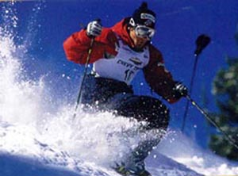
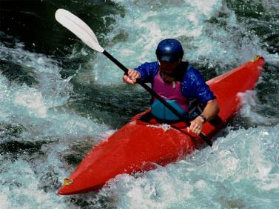
Thank you
for attention

Slide 23
Resources:
К.И.Кауфман, М.Ю.Кауфман. Happy English.ru: учебник англ.яз для 7 кл. общеобразоват. учрежд. – Обнинск: Титул, 2009.
К.И.Кауфман, М.Ю.Кауфман. Книга для учителя к учебнику” Happy English.ru” для 7 кл. общеобразоват. учрежд. – Обнинск: Титул, 2009.
Г.Л. Кубарьков, И.А. Тимощук. 1000. Сборник новых тем современного английского языка. – Москва: ЗАО «БАО-ПРЕСС», 2005.
http://en.wikipedia.org
Image resources:
http://www.smayli.ru/data/smiles/sporta-1350.gif http://www.iceskatingshoes.org/images/ice%20skating%20shoes%202.jpg
http://www.therun.ru/images/imgbig/picture_117.jpeg
http://www.muravlenko.com/uploads/posts/2011-08/1314681197_khfkjdsjkgjgkjdsgjkgkjgkjfg999990000.jpg
http://devushki-oboi.ru/wp-content/uploads/2011/04/razvitie_boksa_za_rubejom_41.jpg
http://s05.radikal.ru/i178/1002/83/e1aab6c8da1a.jpg
http://www.ventasbalss.ru/upload/news/1316068626.jpg
http://www.sektahab.ru/wp-content/uploads/2011/04/football1-330x219.jpg
http://media.fatalgame.com/screen_large/alpine-skiing-2006-4217.jpg
http://www.oformi.net/uploads/gallery/comthumb/191/tennis_wallpaper_desktop.jpg
http://upload.wikimedia.org/wikipedia/commons/e/ed/Bungie-Jumping.jpg
http://upload.wikimedia.org/wikipedia/commons/9/98/Saut_%C3%A0_l%27%C3%A9lastique_Superman_-_Viaduc_de_la_Souleuvre.JPG
http://upload.wikimedia.org/wikipedia/en/4/4e/Ilovechicago.jpg
http://upload.wikimedia.org/wikipedia/en/b/b7/12way2.jpg
http://upload.wikimedia.org/wikipedia/commons/7/77/Rafting_em_Brotas.jpg

Slide 24
http://upload.wikimedia.org/wikipedia/commons/5/5a/Rafting_PescadosRiverClassIV_VeracruzMexico.jpg
http://www.sexshopturkey.com/wp-content/uploads/2010/04/012-surf-new2-300x225.jpg
http://upload.wikimedia.org/wikipedia/commons/c/cb/Surfer_in_Santa_cruz_11-8-9_-1.jpg
http://upload.wikimedia.org/wikipedia/commons/4/4e/Mavericks_Surf_Contest_2010b.jpg
http://forum.nov.ru/uploads/monthly_08_2008/post-35-1219230397.jpg
http://www.allabouttabletennis.com/image-files/concrete-ping-pong-tables.jpg
http://absolut-ekb.narod.ru/gruppovie_programmi/funktsionalnii_trening/functional_training.jpg?rand=217983223242310
http://www.vesi.ru/Map/Gif/2201.gif
http://fta-russia.ru/_fr/0/s7103719.jpg
http://onfit.ru/upload/photo/12300/moscomsport001.jpg
http://yachts.monacoeye.com/files/yachting_developments_symmetry1.jpg
http://www.windsport.am/forms/pkt/ws1.jpg
http://www.clubclassic.cz/img/squash.jpg
http://legacy-cdn.smosh.com/smosh-pit/122010/tobogganing-canada.jpg
http://www.savebyram.org/sitebuilder/images/iStock_000002301435MediumVer2-433x287.jpg
http://www.shashkivsem.ru/wp-content/uploads/2011/08/64-%D0%B2-%D1%81%D0%B0%D0%B4%D1%83.jpg
http://www.chumpysclipart.com/images/illustrations/xsmall2/1394_picture_of_a_happy_smiling_boy_ice_skating.jpg
http://btc-best.ru/images/animation-3.gif
http://upload.wikimedia.org/wikipedia/commons/6/69/Snowboarder_in_halfpipe.jpg
http://upload.wikimedia.org/wikipedia/commons/a/af/Platak_snowboarding_0110_2.jpg
http://upload.wikimedia.org/wikipedia/commons/6/68/Platak_snowboarding_0110_3.jpg
http://www.sport-russia.ru/filestore/0017/0006/99250/79-450.jpg
http://www.victory-cruises.com/graphics/ice_diving.jpg
http://www.echo.msk.ru/att/element-618317-misc-ex13m_700.jpg
http://www.flippersmack.com/wp-content/uploads/2011/10/Scuba-Diving.jpg

Slide 25
http://www.greentrailtours.com.vn/images/gallery/Vietnam_Diving_Tours/Vietnam_Scuba_Diving_Tour/scuba_diving.jpg
http://www.padi.com/scuba/uploadedImages/Scuba_Diving_Trips/Scuba_Diving_Resort_Vacations/Diver%20with%20hawksbill%20sea%20turtle_Image%20Copyright%202009%20-%20Tony%20Rath%20of%20Tony%20Rath%20Photography%20www.tonyrath.com.jpg
http://www.picgifs.com/sport-graphics/sport-graphics/snowboarding/sport-graphics-snowboarding-394599.gif
http://www.bestgraph.com/gifs/sports/equitation/equitation-04.gif
http://www.picgifs.com/graphics/i/ice-hockey/graphics-ice-hockey-972319.gif
http://www.picgifs.com/sport-graphics/sport-graphics/karate/sport-graphics-karate-514818.gif
http://www.gifmania.co.uk/sports/parachute/me_ve_09.gif
http://www.gifs.net/Animation11/Sports/Canoes_and_Sailboats/Rafting.gif
http://www.picgifs.com/sport-graphics/sport-graphics/archery/sport-graphics-archery-015715.gif

