Slide 1
ПЛАН-КОНСПЕКТ ОТКРЫТОГО УРОКА ПО ТЕМЕ «ЦИВИЛИЗАЦИЯ И ПРОГРЕСС. РУКОТВОРНЫЕ ЧУДЕСА СВЕТА» 10 КЛАСС
Второй Всероссийский фестиваль передового педагогического опыта
"Современные методы и приемы обучения"
февраль - май 2014 года
Сафонова Елена Геннадьевна
учитель иностранного (английского) языка
Муниципальное общеобразовательное учреждение
«Средняя общеобразовательная школа №3»
Владимирская область, г. Гороховец
Электронное периодическое издание НАУКОГРАД

Slide 2
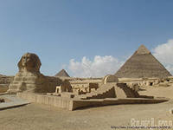
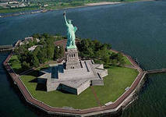
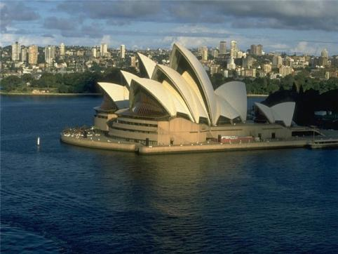
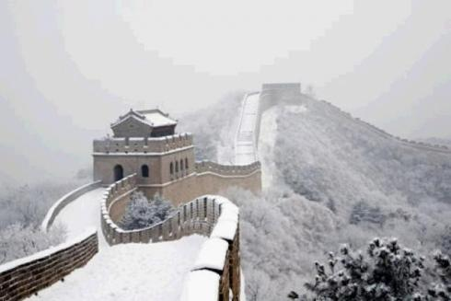
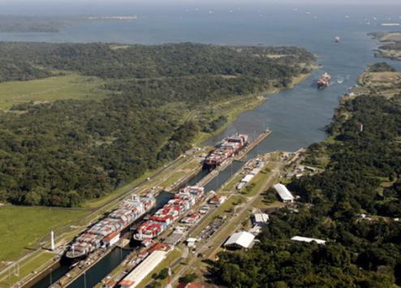
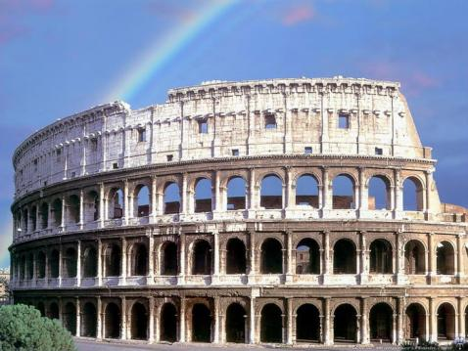
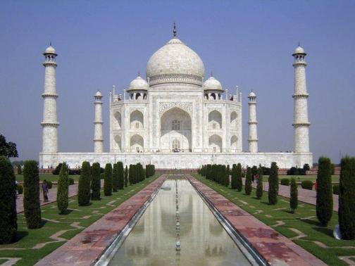
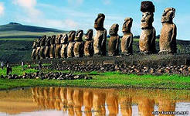
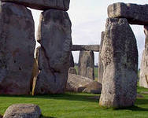
MAN-MADE
WONDERS
OF THE WORLD

Slide 3
PROJECT
FESTIVAL

Slide 4
Man-made Wonders of the World
Author, Project | Where? | When? | Why? | How?
Morosova Christina, “Stonehenge” | Great Britain, England, Wiltshire | 3000 BC - 2100 BC | magic; ancient observatory | fire; special stone tools; wooden lances(копья, пики)
Senenko Vladimir, “Great & Powerful Pyramids of Giza” | Egypt, Giza | 26-23 centuries BC | graves; repeaters (передающие устройства) | move and lift stone blocks; wooden rolls; levers (рычаги)
Seriakov Ilya, “Colossus of Rhodes” | Greece, Rhodes Island | 3d century BC | to thank and honour the God (Helios) | tools for transportation; bronze sheets; iron rungs (скобы); sand
Tsariova Yulia, “Ershovs’ House” | Russia, Vladimir region, Gorokhovets | 17th century | to protect the owners | white stone; wood; ladders
Tarakanova Victoria, “Bold Mount” | Russia, Vladimir region, Gorokhovets | 13th century? | natural object? Khan’s grave? | stones covered with ground?

Slide 5
ANALYSIS
1). Have you found out anything new
from the projects? What is it?
2). What have impressed you most of all/
least of all? Why?
3). Would you like to learn more about
any object you’ve seen and heard of today? How would you do it? What sources of information would you choose? Why?

Slide 6
CIVILIZATION AND PROGRESS
LEARNING FROM THE PAST
Are these topics interconnected? How?
PROGRESS AND DEVELOPMENT
Is the existence of any man-made
wonders possible without civilization,
progress and development?
MAN-MADE WONDERS OF THE WORLD
Should we learn from the past? Can we do it? How? What for? Can you give any examples from the previous sections?
ROBOTS OF THE FUTURE
???

Slide 7
HOMETASK
Ex.8 р.60 (WB) – письмо в защиту технологического прогресса
Ex.1-6 р.125-127 - подготовка к четвертному тестированию
особое внимание – письменной (ex.5 р.127)
и устной (ex.6 р.127) частям

