Slide 1
Второй Всероссийский фестиваль передового педагогического опыта
«Современные методы и приемы обучения»
февраль - май 2014 года
Презентация
для урока английского языка
в 7 классе на тему
Diseases of Our Blue Planet
Электронное периодическое издание НАУКОГРАД
февраль - май 2014 года

Slide 2
 | А | В | С | D | Е
1 | take | is | take | morning | and
2 | rain | care | the | you | sun
3 | it | life | teacher | will | boys
4 | the | school | of | in | Earth
1 – C, 2 – B, 4 – C, 2 – C, 4 – E, 1 – E,
3 – A, 3 – D, 1 – C, 2 – B, 4 – C, 2 – D

Slide 3
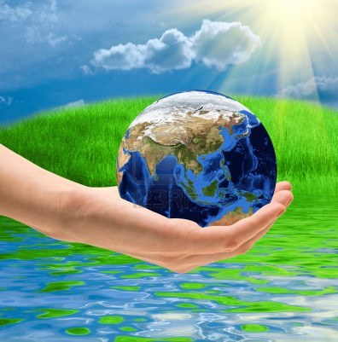
“Take care of the earth and
it will take care of you”
Author Unknown

Slide 4
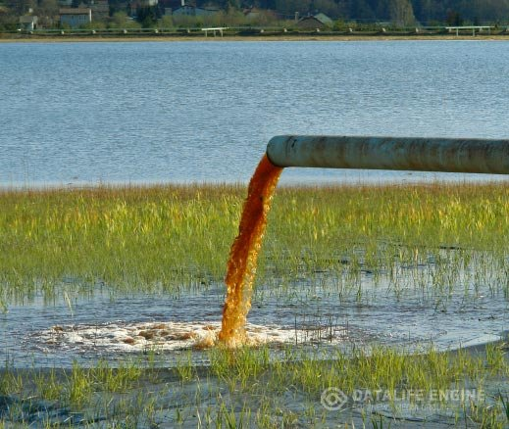
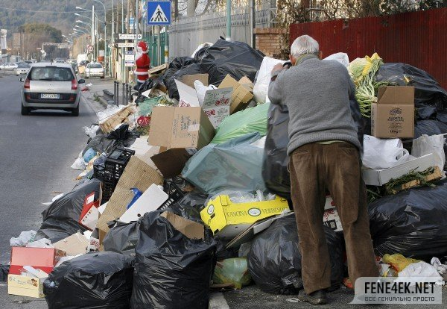
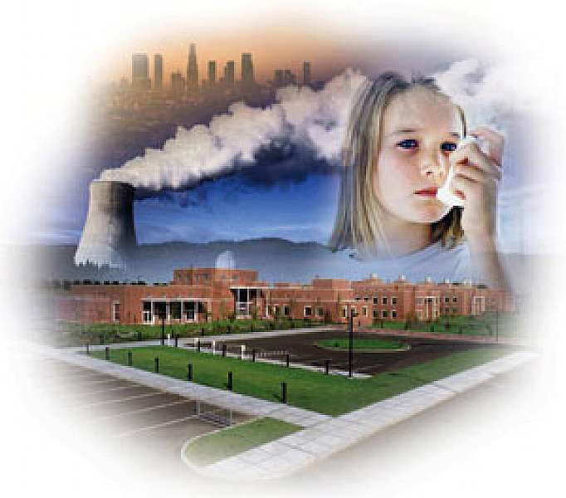
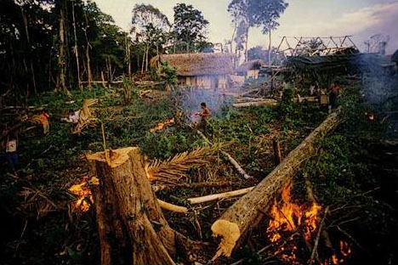
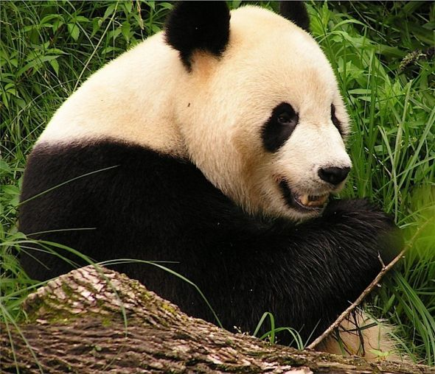
Diseases of Our Blue Planet

Slide 5
Plan of the Lesson:
1. Anticipate the topic.
2. Express your expectations.
3. Get some information from the Net.
4. Do some quizes & revise the vocabulary.
5. Find the information on the Net.
6. Generate and share ideas in a group.
7. Apologize & say what we can do.
8. Realise what have you learnt.
9. Thank everyone.

Slide 6
1. Ecology | Environment QUIZ a) Air that we breathe consists of it.
2. Environment | b) Animals of a region.
3. Flora | c) Science about living creatures and plants in their surroundings.
4. Fauna | d) Plants of a region.
5. Habitat | е) When land, sea or air become dirty or poisonous.
6. Pollution | f) Everything around us.
7. Oxygen | g) Natural living place of animals or plants.
8. Acid rain | h) Rain containing acid.

Slide 7
QUIZ - key
c) Science about living creatures and plants in their surroundings.
1. Ecology
2. Environment
f) Everything around us.
3. Flora
d) Plants of a region.
4. Fauna
b) Animals of a region.
5. Habitat
g) Natural living place of animals
or plants.
6. Pollution
е) When land, sea or air become dirty or poisonous.
7. Oxygen
a) Air that we breathe consists of it.
8. Acid rain
h) Rain containing acid.

Slide 8
Decomposition Quiz
Bus ticket - 2 months / 1 month / 3 months
Banana peel - up to 2 months / 4 months / 6 months
Wool sock - 1 year / 3 years / 4 years
Piece of wood - 6 years / 4 years / 3 years
Painted piece of wood - 10 years / 13 years / 15 years
Aluminium can - 200 years / 100 years / 150 years
Plastic bottle - up to 300 years / 400 years / 500 years
Glass container – forever / 1000 years / 10 years

Slide 9
Decomposition Quiz
Bus ticket -
1 month
Banana peel -
6 months
Wool sock -
1 year
Piece of wood -
4 years
Painted piece of wood -
13 years
Aluminium can -
100 years
Plastic bottle -
500 years
Glass container -
forever!!!

Slide 10
Презентация выполнена
учителями английского языка
ГБОУ школы № 578
г. Санкт-Петербурга
Орловской Т.Е. и Шигаюповой Т.Г.

