Slide 1
Всероссийская научно-методическая конференция 10 ноября 2013 - 30 января 2014 "Педагогическая технология и мастерство учителя"
КОНСПЕКТ УРОКА
АНГЛИЙСКОГО ЯЗЫКА
ПО ТЕМЕ «CHRISTMAS DAY»
Работа выполнена
учителем английского языка
БОУ г. Омска "СОШ №68"
Шевелевой Н. А.
Электронное периодическое издание НАУКОГРАД
Ноябрь 2013 – февраль 2014

Slide 2
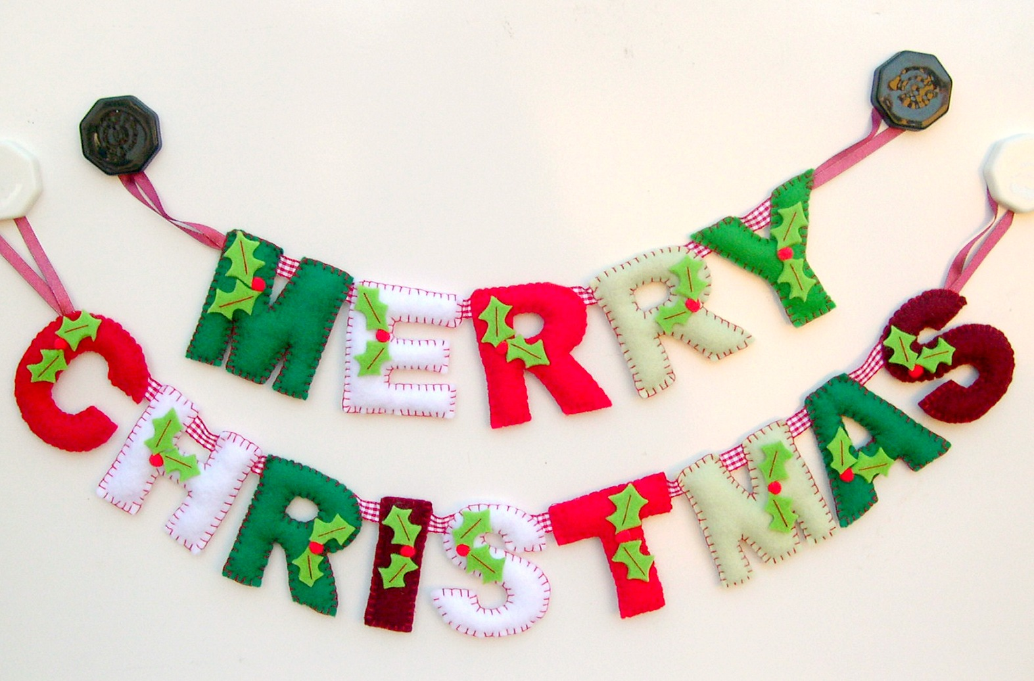

Slide 3
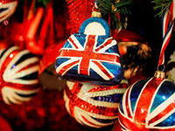
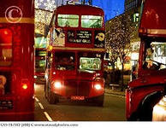
Christmas Day, December 25, is probably the most popular holiday in Great Britain.

Slide 4
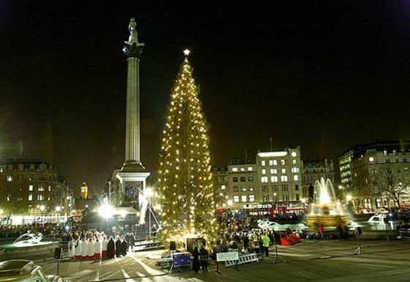
In early December, the traditional tree reaches a height of 20 meters from Oslo to London and set for Christmas in Trafalgar Square. This tradition has existed since 1946. Christmas tree sends to England royal family of Norway in gratitude for the assistance that the British had in Norway during World War II.

Slide 5
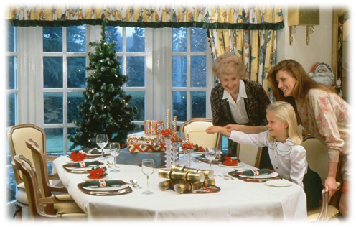
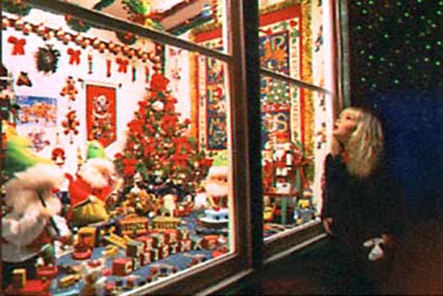
It is a family holiday. Traditionally all relatives and friends give each other presents. So, before Christmas all the department stores and shops are crowded, everybody is choosing a present.

Slide 6
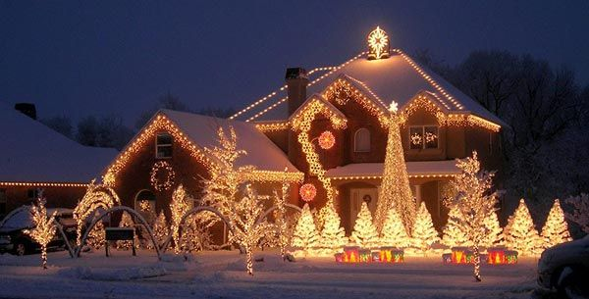
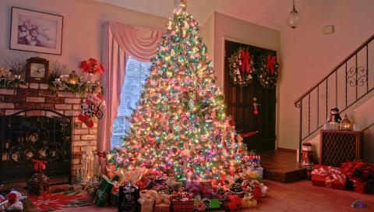
In general, people get prepared for this holiday very carefully. They decorate their houses in the traditional way. Christmas trees are set up in houses, in the streets and churches. They are always decorated with fairy lights, angels and small toys. In addition, little packets with nuts, candies and special biscuits are hung on the tree. Presents are put around the tree and artificial «frost» is scattered over the branches.

Slide 7
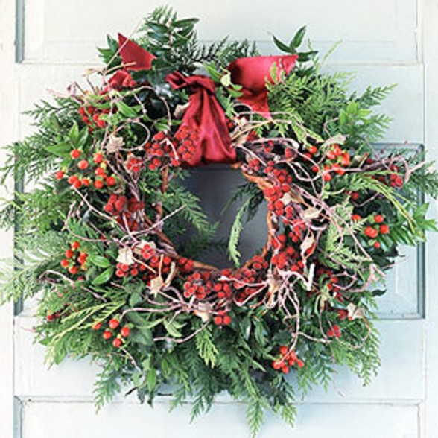
Besides the Christmas tree, holly and mistletoe are used to decorate the house. Branches of holly are put up behind pictures and mistletoe is hung over doors, so the young people have a chance to kiss the girls under it, plucking each time a red berry from the mistletoe. It is said that the girl who was not kissed under it at Christmas would not get married that year.

Slide 8
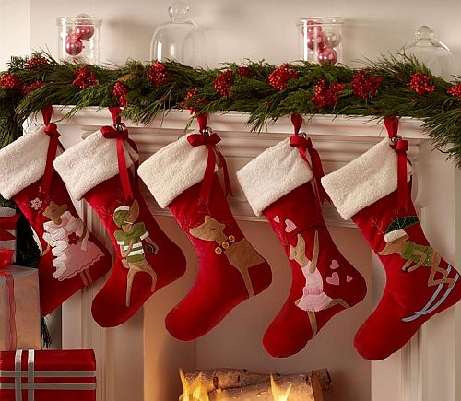
On the eve of Christmas children hang their stockings, so that Santa Claus could put presents into them: oranges, sweets, nuts and if the child didn't behave properly Santa Claus can put there a piece of coal as punishment.

Slide 9
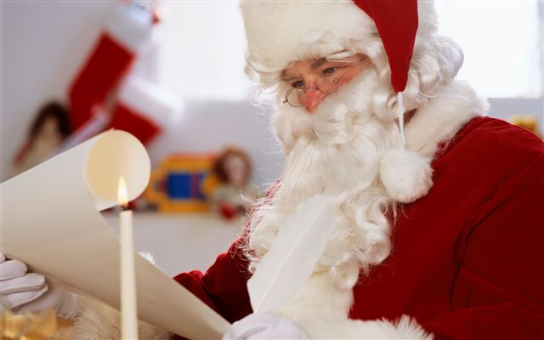
Santa Claus got his name from a man known as St. Nicolas, who lived in the fourth century. He gave his wealth to the poor and often to children. After he died, the Dutch brought this legend to colonial America. Soon the Dutch name Sinter Klaus became Santa Claus.

Slide 10
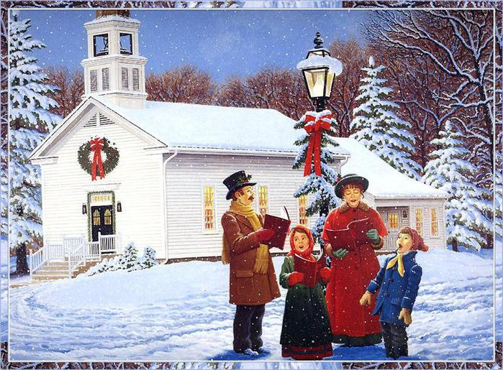
Carol singing is an essential part of Christmas. No church or school is without its carol service. Carols may be traditional or with some variations that express different feelings. Carols were used for the first time during Christmas in the fifteenth century.
Usually children come around in the evening to the front doors and start singing carols and people who live in these houses give children candies, nuts, pies and so on, to thank them for carol singing.

Slide 11
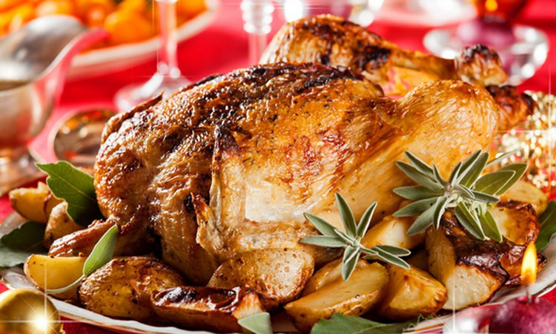
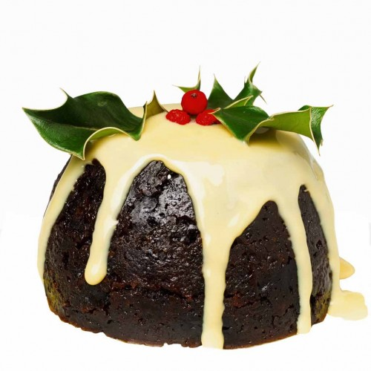
A typical Christmas lunch includes turkey with cranberry sauce and pudding. Every young woman in each household helps to stir the Christmas pudding, if she wishes to be married that year. Usually a coin or two are hidden inside the pudding and part of the fun is to see who finds it.

Slide 12
One of the ancient British traditions - Christmas log. It is believed that the ancient Vikings brought this rite in England. At Christmas, they sawed down a huge tree, and it is stored for the whole year - dried up. Until the next Christmas he was brought into the house, and it burned in the hearth for a long time. If faded, not burned to ashes, the hosts were expecting trouble.

Slide 13
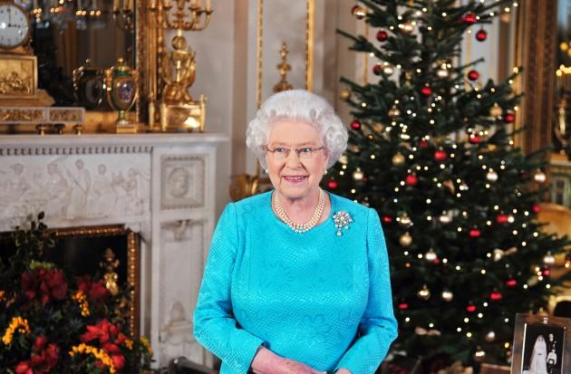
After the lunch they go to the sitting room to listen to the Christmas speech of the Queen, shown on TV.
So, Christmas is a merry family holiday for all the people of Great Britain. Christmas comes but once a year.

Slide 14
The twenty-sixth of December in the UK it is also a holiday - Boxing Day. On television from morning to evening are sports programs, so the British love to spend the day in a chair watching TV. Holiday ends exactly twelve days after Christmas, the sixth of January, when start shooting decorations.

