Slide 1
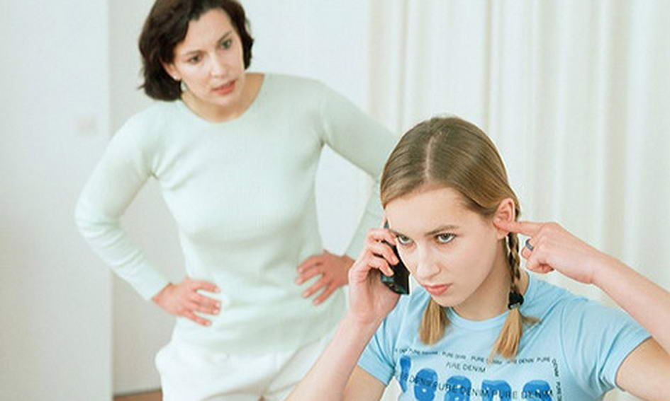
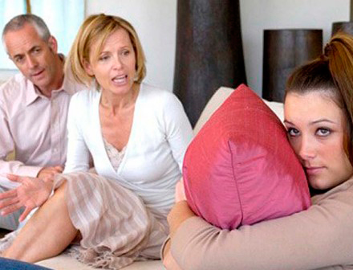
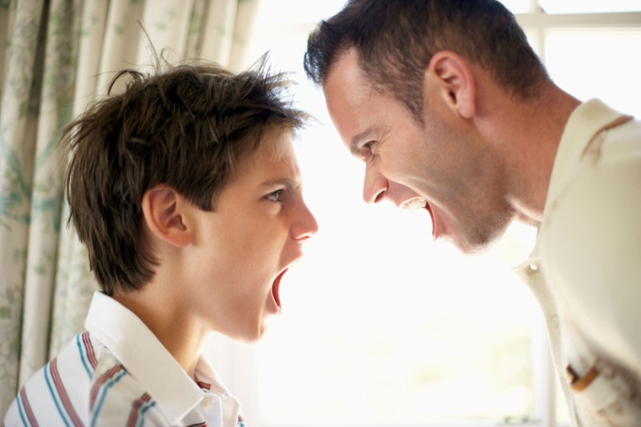
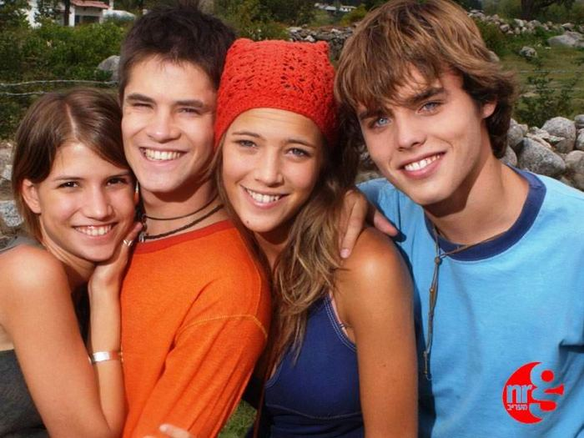
“THE WAY WE ARE”
Всероссийская научно-методическая конференция 10 ноября 2013 - 30 января 2014 "Педагогическая технология и мастерство учителя"
Нахтармина И.Г.
Гимназия 171
If we could see ourselves as others see us, we would probably change our views.
Электронное периодическое издание НАУКОГРАД
Ноябрь 2013 – февраль 2014

Slide 2
The plan of the lesson:
1. Introduction of the topic and aim of the lesson.
2. Description of people’s appearance.
3. Description of people’s personalities.
4. Listening to different people’s opinions about Sue’s personality. Discussion.
5. Reading and discussion e-mails from teenagers asking for advice.
6. Sharing ideas about possible solution to their problems.
Analysis of the lesson.
Home task.

Slide 3
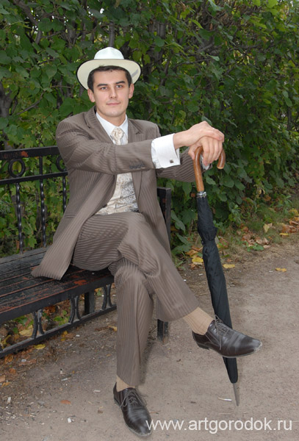
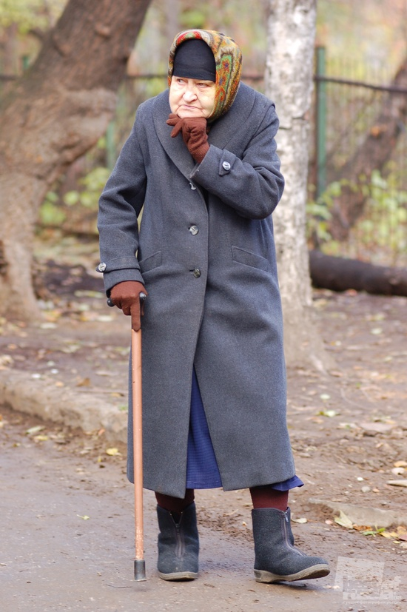
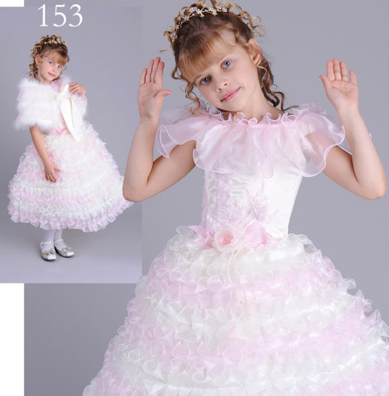

Slide 4
Affectionate
Ambitious
Assertive
Broad-minded
Communicative
Composed
Considerate
Determined
Devoted
Easy-going
Generous
Good-natured
Honest
Impartial
Just
Kind-hearted
Loyal
Reliable
Modest
Merciful
Strong-willed
Supportive
Sympathetic
Tolerant
Witty
Arrogant
Conceited
Capricious
Cruel
Dishonest
False
Fussy
Greedy
Hard-hearted
Haughty
Hostile
Ill-tempered
Impertinent
Inconsiderate
Indifferent
Indifferent
Intolerant
Obstinate
Revengeful
Self-willed
Showy
Tactless
Uncommunicative
Unrestrained
Vain

Slide 5
What adjectives would you use to describe these people?
Linda wants to become a top fashion designer.
Nick always makes everybody laugh.
Bob often buys things for his brothers and sisters.
Sue learns quickly and understands new things easily.
Phil is never worried that he’s going to do something stupid.
It’s so easy to upset Ann. If you say the wrong thing you will hurt her feelings.
Jane never does anything stupid.
Paul only thinks of his own needs and never thinks about other people.
Dick often promises to do things but half the time he forgets.
Jessica never shows her feelings.
intelligent, sensible, self-confident, reserved, generous, ambitious, sensitive, unreliable, selfish, funny.

Slide 6
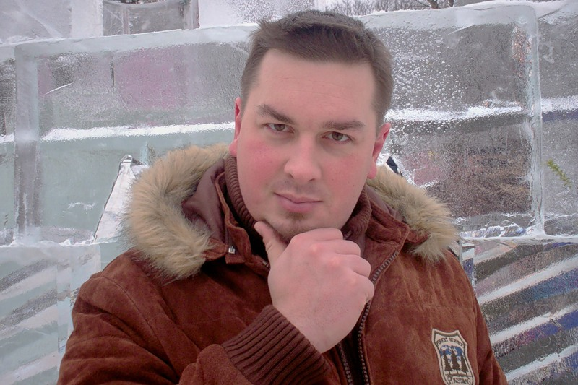
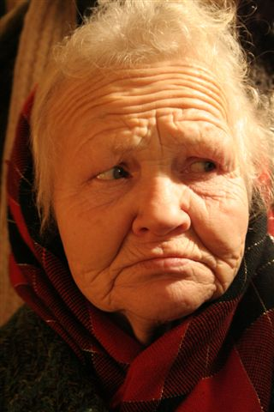
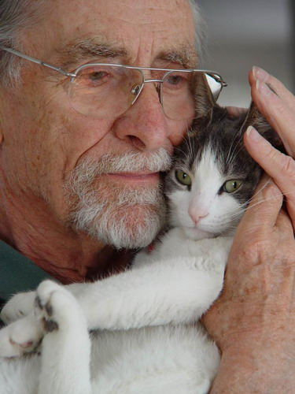
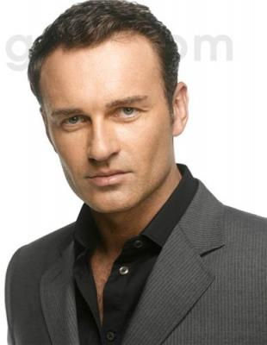
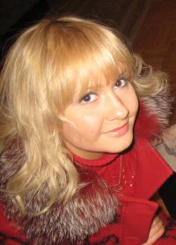
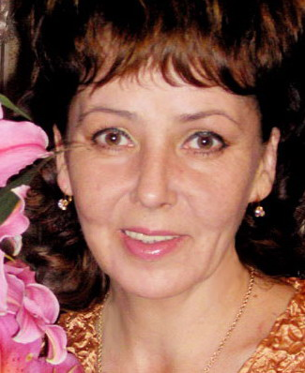
Robert
Mr. Wilson
Mrs. Hudson
Dominic
Marianna
Linda

Slide 7
Mrs. Hudson is confident and powerful. She worked as an accountant for thirty five years and can’t put up with the fact that she is a pensioner now. She capricious and self-willed, punctual and scrupulous.
Robert is a rather shy and modest man. It’s difficult for him to communicate with people. He tries to hide it and sometimes can be too talkative and familiar. He is thoughtful and serious, and likes being alone.
Mr. Wilson is a cruel and insensitive person. He often can’t control his emotions and blows off steam. He is a double-faced person. So he can seem rather sympathetic and kind-hearted . Be careful! He is wanted for a murder.
Marianna is a greedy and showy person. She runs a bar and an expert in wines. She is reserved and never shows her real feelings.
Dominic is tough and competitive as he is a managing director of a big firm. He is determined, self-possessed and strong-willed. At the same time he is communicative , just and considerate.
Linda is a broad-minded and well-educated person. She is good at studying. She is ambitious and persistent and never gives up. Linda is reliable and you can be sure that she won’t let you down.

Slide 8
Do you feel you are a different person in different situations?
Do you speak differently when you are with different people? Who? When?
Do you argue with some people but not others?
Who do you argue with? When?
Do you feel that you are more talkative with people of your age than with adults?
Why?

Slide 9
Listen to the descriptions of Sue and try to guess who speak about her. Match the descriptions to people : her father, mother, friend, boy-friend, neighbour.
What are the features of character each person is speaking about ?
Try to describe Sue using traits of her character from the descriptions.

Slide 10
A great variety of things can influence people’s relationships often causing misunderstanding that in turn leads to arguments, quarrels and scandals.
People often regret about their behaviour. How can you express regret in English?
Look at the example:
Example:
Greg refused to congratulate Helen’s mother on her birthday. Helen decided not to speak to him.
Greg regrets about his behaviour:
If only I hadn’t refused to congratulate Helen’s mother, we wouldn’t have quarreled.
Give advice to people using conditional sentences (III type):
1.Jane was two hours late for a meeting. When she arrived nobody was waiting for her.
2.Michael was afraid of the dog and tried to run away. Rachel didn’t respect him anymore.
3.Kate loved to laugh at Nick and he decided not to go out with her.
4.Margaret was wearing an ugly dress. Nobody danced with her at the party.
5.Henry was very arrogant so nobody loved him.
6.Herbert asked too many questions and was a real bore. His classmates didn’t invite him for the party.

Slide 11
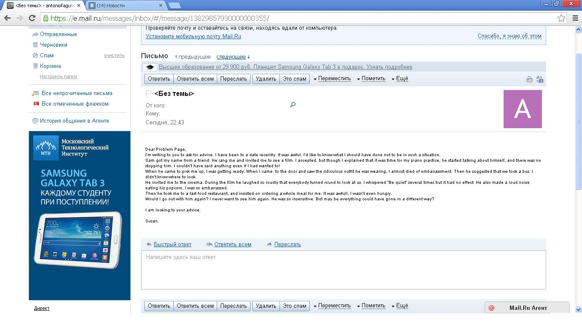
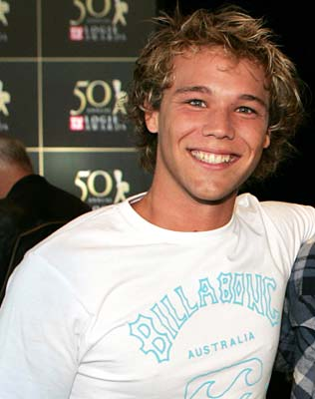
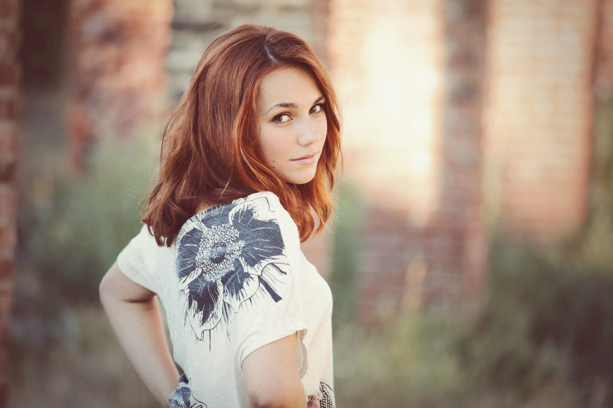
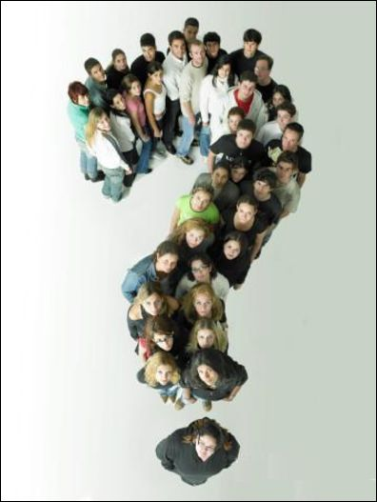

Slide 12
HOME TASK
-Write the sentences giving advice to Sam and Susan. Use conditional sentences to say what could have been done to improve the situations and what you would have done if you had been Sam or Susan.
-Write an electronic message to reply Sam and Susan. Use conditional sentences to say what could have been done to improve the situations and what you would have done if you had been Sam or Susan. Share your ideas about an appropriate way young people living in Saint-Petersburg should communicate.

