Slide 1
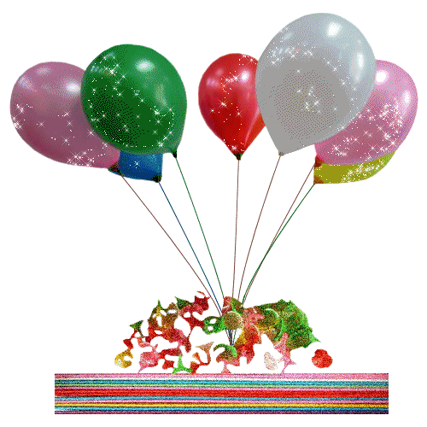
Всероссийская научно-методическая конференция
"Педагогическая технология и мастерство учителя"
Работу выполнила
учитель английского языка
Алексеева Л.Б.
Муниципальное бюджетное общеобразовательное учреждение
"Школа № 5"
Ямало-Ненецкий автономный округ, Тюменская область, г. Муравленко
Электронное периодическое издание НАУКОГРАД

Slide 2
Phonetic exercises
[w] when ,what, would, winter
[ʌ] puzzle, bus, duck, summer
[ə:] first, third, birthday, thirty
[θ] thank , sixth, birthday, third
[ou] home, no, go, rose

Slide 3
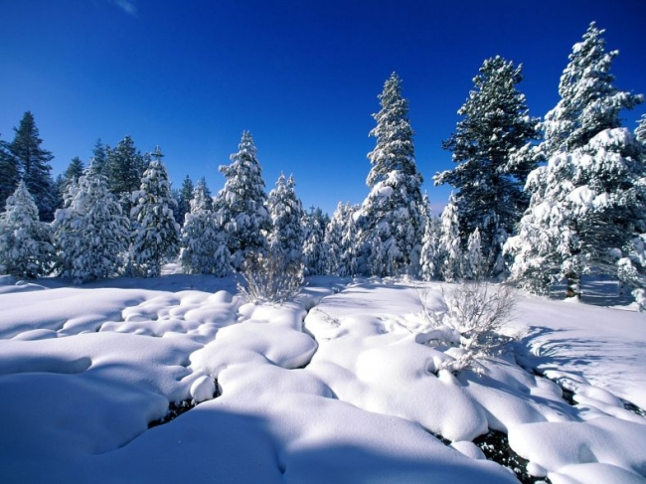
Winter months : January February December

Slide 4
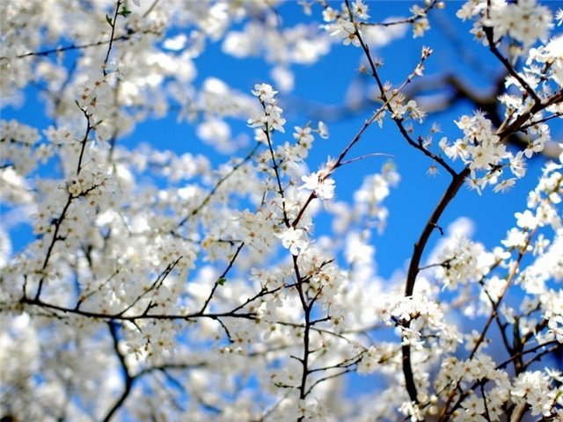
Spring months : March
April
June

Slide 5
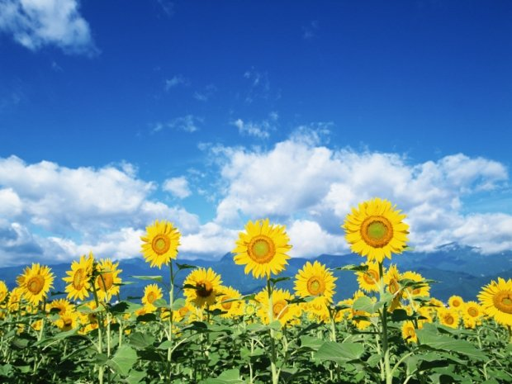
Summer months :
June
July
April

Slide 6
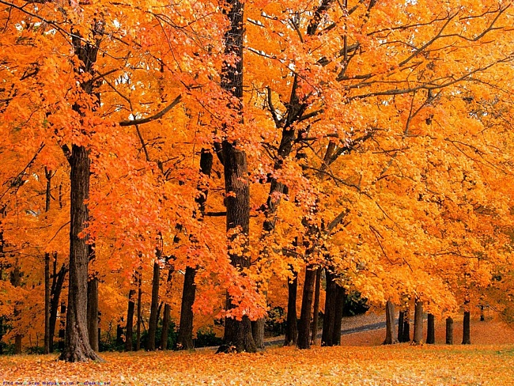
Autumn months :
September
October
November

Slide 7
When’s your birthday? My birthday’s in … .

Slide 8
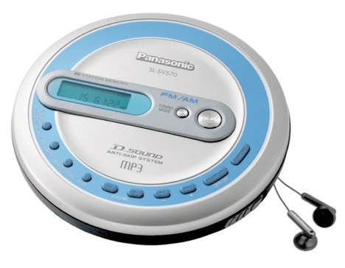
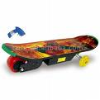
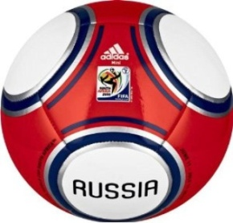
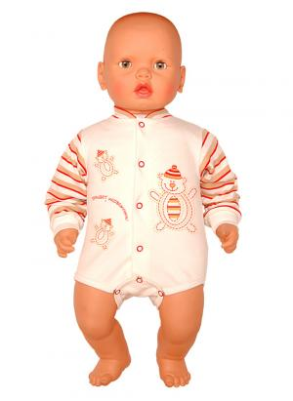
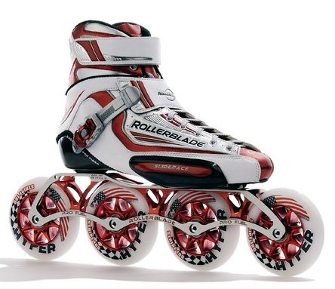
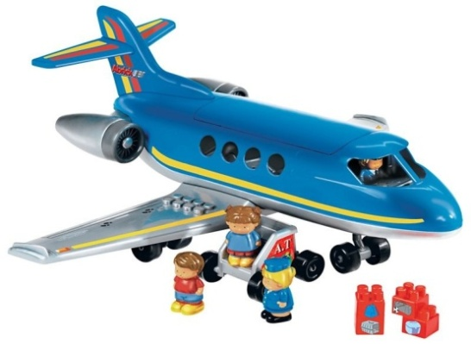
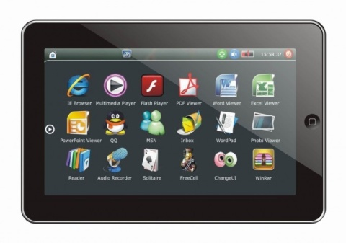
Presents

Slide 9
What would you like for your birthday? I’d like … .

Slide 10
Let’s sing
What would you like for your birthday?
What would you like for your birthday?
What would you like for your birthday?
A scooter, a book or a bike?
I’d like a CD and a bike.
I’d like a book and a kite.
I’d like a video cassette
And a cuddly and fluffy pet.

Slide 11
Let’s play!

Slide 12
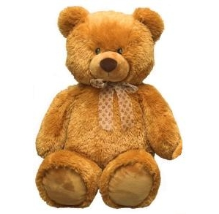
 |  |  | 1
 |  | 2
 |  |  | 4
 | 5

Slide 13
 |  |  | 1 | b | e | a | r
 |  | 2
 |  |  | 4
 | 5

Slide 14
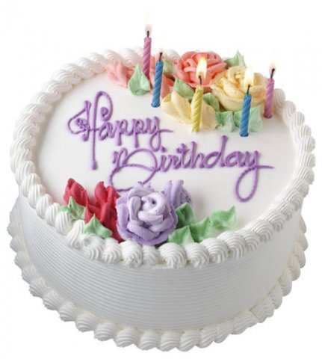
 |  |  | 1 | b | e | a | r
 |  | 2
 |  |  | 4
 | 5

Slide 15
 |  |  | 1 | b | e | a | r
 |  | 2 | c | a | k | e
 |  |  | 4
 | 5

Slide 16
 |  |  | 1 | b | e | a | r
 |  | 2 | c | a | k | e
 |  |  | 4
 | 5

Slide 17
 |  |  | 1 | b | e | a | r
 |  | 2 | c | a | k | e
d |  | o | l | l
 |  |  | 4
 | 5

Slide 18
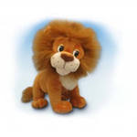
 |  |  | 1 | b | e | a | r
 |  | 2 | c | a | k | e
d |  | o | l | l
 |  |  | 4
 | 5

Slide 19
 |  |  | 1 | b | e | a | r
 |  | 2 | c | a | k | e
d |  | o | l | l
 |  |  | 4 | l | i | o | n
 | 5

Slide 20
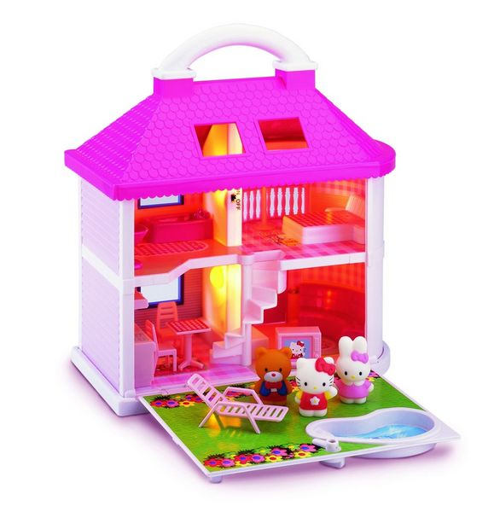
 |  |  | 1 | b | e | a | r
 |  | 2 | c | a | k | e
d |  | o | l | l
 |  |  | 4 | l | i | o | n
 | 5

Slide 21
 |  |  | 1 | b | e | a | r
 |  | 2 | c | a | k | e
d |  | o | l | l
 |  |  | 4 | l | i | o | n
 | 5 |  | h | o | u | s | e

Slide 22
 |  |  | 1 | b | e | a | r
 |  | 2 | c | a | k | e
d |  | o | l | l
 |  |  | 4 | l | i | o | n
 | 5 |  | h | o | u | s | e

Slide 23
 |  |  | 1 | b | e | a | r
 |  | 2 | c | a | k | e
d |  | o | l | l
 |  |  | 4 | l | i | o | n
 | 5 |  | h | o | u | s | e
 | 6 |  | b | o | o | k

Slide 24
 |  |  | 1 | b | e | a | r
 |  | 2 | c | a | k | e
d |  | o | l | l
 |  |  | 4 | l | i | o | n
 | 5 |  | h | o | u | s | e

Slide 25
 |  |  | 1 | b | e | a | r
 |  | 2 | c | a | k | e
d |  | o | l | l
 |  |  | 4 | l | i | o | n
 | 5 |  | h | o | u | s | e
 | 6 |  | b | o | o | k
p | l |  | a | n | e

Slide 26
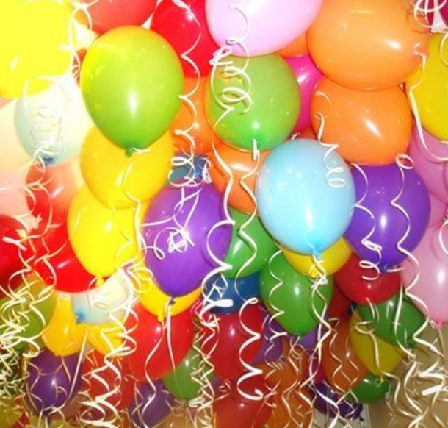
 |  |  | 1 | b
 |  | 2 |  | a
 |  |  |  | l
 |  |  | 4 | l
 | 5 |  |  | o
 |  |  |  | o
 |  |  |  | n

Slide 27
Clever of you !

Slide 28
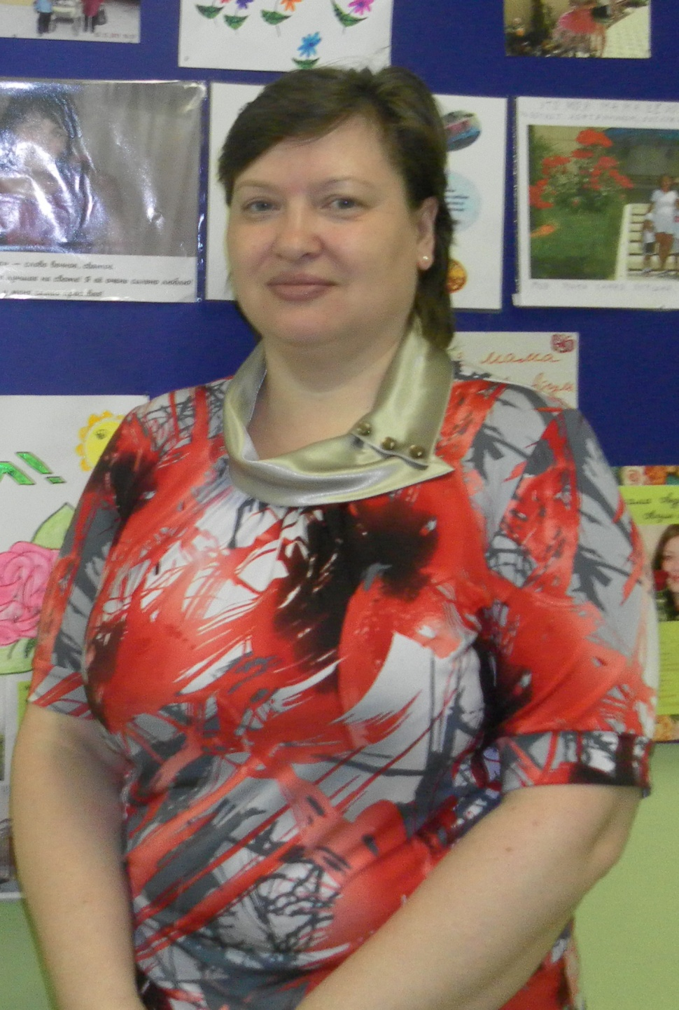
Svetlana Vasilevna

Slide 29
Happy Birthday!
Dear teacher!
I wish you
Be happy!
Love, … .
Happy Birthday!
Dear teacher!
I wish you
Good luck!
Love, …

Slide 30
Let’s sing
Happy birthday to you,
Happy birthday to you, Happy birthday , dear teacher,
Happy birthday to you!

Slide 31
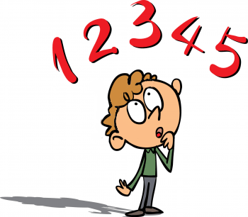
The lesson is…
Fine!
Good!
OK!

Slide 32
Homework
AB p. 26 ex. 1,2
Birthday card.

